Slide 1


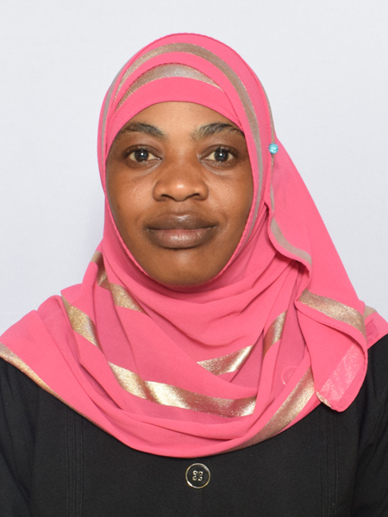
Tuberculosis Preventive Therapy efficacy among People Living with HIV (PLHIV) accessing
Comprehensive Care Services at Umoja Health Centre, Nairobi, Kenya.
Mwajuma Abdullahi Ramadhan,
Umoja Health Centre, Nairobi, Kenya.

Slide 2
AUTHORS AND AFFILIATIONS
Authors:
M. Ramadhan1, S. Mong’are1, J. Nelima1, A. Ngano1, G. Wairimu1, R . Nyaosi2, D. Odok2, A.Okumu2, C. Ngunu3 E. Mueni3
Affiliations:
1. Umoja Health Centre, Nairobi, Kenya.
2. Embakasi West Sub county, Nairobi, Kenya.
3. Nairobi City County, Kenya.
4. SHINE Project, Nairobi City County, Kenya

Slide 3
Introduction:
TB disease. Tuberculosis Preventive Therapy (TPT) is a combination of anti-TB drugs taken to prevent Tuberculosis(TB) disease and it works well with Antiretroviral Therapy (ART) to reduce TB morbidity and mortality among PLHIV.
According to WHO 2017, PLHIV are 30 times more likely to develop active TB and accounts for 30% of AIDS related deaths worldwide.
Therefore, TPT is a crucial and cost-effective component of HIV care and is strongly recommended by WHO in treating latent TB.
This study aimed to determine the efficacy of TPT among PLHIV in preventing

Slide 4
Methods
A retrospective data of 636 PLHIV clients who had taken TPT and completed was extracted from Kenya EMR and TB4 Register at Umoja Health Centre between January 2020 to August 2024.
Data extracted from Kenya EMR system included the following information: gender, age, those who were started on TPT and those who completed, TB4 register had the information of patients who were infected with TB after TPT completion.
Data collected was analyzed using Microsoft Excel.

Slide 5
GENDER PRESENTATION IN TPT UPTAKE n-636

Slide 6
AGE BRACKET SEGREGATION OF TPT UPTAKE

Slide 7
TPT UPTAKE

Slide 8
Reasons not completed TPT

Slide 9
Those Infected with TB disease after TPT Completion

Slide 10
TPT Efficacy

Slide 11
Conclusion
TPT uptake was at 100%, completion at 90% while efficacy of TPT was at 98%.
Females were more infected with TB disease after TPT completion at 67% as compared to males at 33%.
Therefore TPT is a crucial component of care in PLHIV to prevent TB disease.

Slide 12
My Co-authors
Umoja H/C
Embakasi West Sub- county
SHINE project Nairobi City County
IPNET Kenya
Acknowledgement
Thank you

